Slide 1
Multithreading in Java
Presented by
Munieswaran.N

Slide 2
Why Multithreading
To perform multiple actions parallelly
Make better use of your CPU. CPU may be blocked by IO or other stuff. While waiting, why not letting other threads use it
we can divide our job into several independent parts. For example, suppose you have to execute a complex database query for fetching data and if you can divide that query into sereval independent queries, then it will be better if you assign a thread to each query and run all in parallel. In that way, your final result output will be faster. Again, this is an example when you have the leverage to run mutliple database queries.

Slide 3
Multithreaded programming has these characteristics:
Multiple Threads are from one Runnable Interface
Threads share the same data and code
Eg: Thread t1 = new Thread(r);
Thread t2 = new Thread(r);
CPU
CODE
DATA

Slide 4
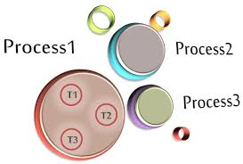
Usage
In word pad, typing a text uses one thread and word correction is checked by another thread.
In whats app multiple users request the server at same time for sending message to another user, then server assigns each user one thread. Then all user requests are executed at same time.
In gaming also multi threading is used
All latest operating systems are multi threaded

Slide 5
Advantages
Multi tasking: You can perform many operations together so it saves time.
Responsive: As there are different threads running in each program then if one thread stops working then other threads keep the program running and response to the user quickly.
Resource utilization: Idle time of CPU becomes less as there are several threads running in each program.
Parallel execution: In multiprocessor multiple tasks/threads of the program complete in parallel.
Large programs run smoothly: If you have a high-end processor with multicore inside processor then large programs run without any problem. In complex GUI apps there exist many threads and each thread performs its own work. So without interfering with the operating system, large programs perform well. If any thread stops responding then other thread take care of it.
Data sharing: Threads within a program share same data with each other so there is no extra space required for each thread.

Slide 6
Disadvantages
Security: As threads within a program share same data so if any unknown thread comes then it can change data.
Thread Cloning: If one thread wants to clone then other threads in a program needs to reassign data
Blocking program: Suppose there is single kernel thread handling the whole program, if that kernel thread stops then it will result in blocking the whole program.
Slow down the system: If there is single core processor running then multithreading slows down the computer as there become a heavy load on the single processor.

Slide 7
Thread State
public static enum Thread.State extends Enum<Thread.State>
A thread state. A thread can be in one of the following states:
NEW - A thread that has not yet started is in this state.
RUNNABLE - A thread executing in the Java virtual machine is in this state.
BLOCKED - A thread that is blocked waiting for a monitor lock is in this state.
WAITING - A thread that is waiting indefinitely for another thread to perform a particular action is in this state.
TIMED_WAITING - A thread that is waiting for another thread to perform an action for up to a specified waiting time is in this state.
TERMINATED - A thread that has exited is in this state.

Slide 8
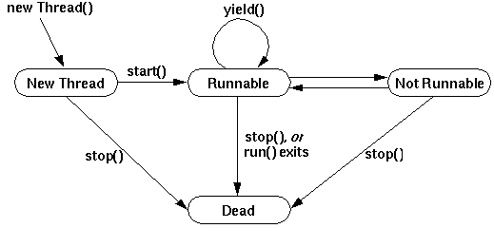
Thread State cont..
There is no state called RUNNING in Thread State enum

Slide 9
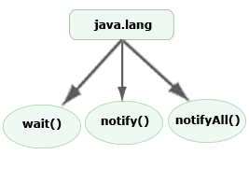
Inter Thread communication Methods used
The Object class in java contains three final methods that allows threads to communicate about the lock status of a resource. These methods are wait(), notify() and notifyAll(). So today we will look into wait, notify and notifyAll in java program.

Slide 10
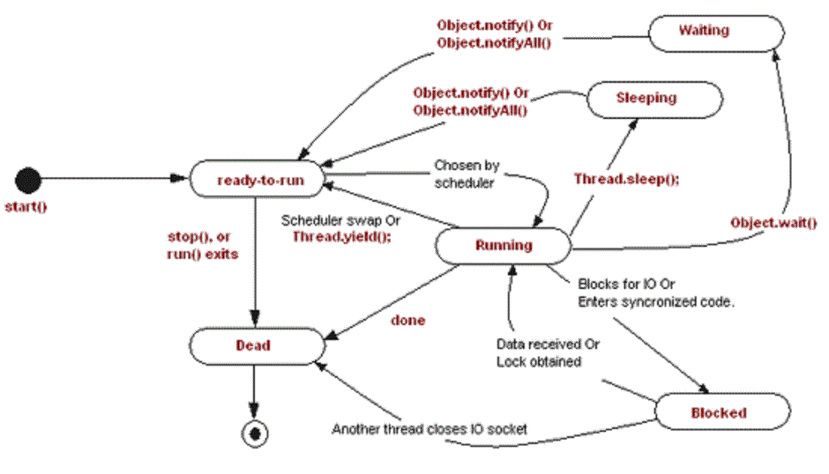
Inter thread communication explained

Slide 11
Lets discuss few methods
1) wait() method
Causes current thread to release the lock and wait until either another thread invokes the notify() method or the notifyAll() method for this object, or a specified amount of time has elapsed.
The current thread must own this object's monitor, so it must be called from the synchronized method only otherwise it will throw exception.
Method | Description
public final void wait()throws InterruptedException | waits until object is notified.
public final void wait(long timeout)throws InterruptedException | waits for the specified amount of time.

Slide 12
2) notify() method
Wakes up a single thread that is waiting on this object's monitor. If any threads are waiting on this object, one of them is chosen to be awakened. The choice is arbitrary and occurs at the discretion of the implementation.
Syntax: public final void notify()
3) notifyAll() method
Wakes up all threads that are waiting on this object's monitor. Syntax: public final void notifyAll()

Slide 13
Contn..
isAlive() method is used to check the existance of a thread and used to find the status of the thread, returns a boolean result.
join() method allows a thread to wait until the thread, on which it is called terminates.
Public final void join() throws IntrupptedException
Yield() give other threads a chance to execute.

Slide 14
Thread Priority
JRE executes threads based on their priority.
A CPU can execute only one thread at a time.
The threads are scheduled by JRE by using fixed-priority scheduling.
Each thread has a priority that affects its position in the thread queue of the processor.
A thread with a higher priority runs before threads with a lower priority.
Thread priorities are integer values in the range of 1 to 10 that specify the priority of one thread with respect to the priority of another thread.

Slide 15
Cont..
If the processor encounters another thread with a higher priority, the current thread is pushed back, and the thread with the higher priority is executed.
The next thread of a lower priority starts executing if a higher priority thread stops or becomes not runnable.
A thread is pushed back in the queue by another thread if it is waiting for an I/O operation.
A thread can also be pushed back in the queue when the time for which the sleep() method was called on another higher priority thread gets over.

Slide 16
Cont..
You can set priority to threads using the setsetPriority() method of the Thread class. The signature of the setPriority() method is : public final void setPriority(int newPriority)
The priority levels should be within the range of two constants, MIN_PRIORITY and MAX_PRIORITY. (0 to 10)

Slide 17
FAQ
What will happen if you start a thread twice?
No. After starting a thread, it can never be started again. If you does so, an IllegalThreadStateException is thrown. In such case, thread will run once but for second time, it will throw exception.
What is the difference between a process and a thread?
Threads are used for small tasks, whereas processes are used for more 'heavyweight' tasks – basically the execution of applications. Another difference between a thread and a process is that threads within the same process share the same address space, whereas different processes do not.

Slide 18
FAQ
Can we execute a program without main () method?
Yes You can compile and execute without main method By using static block. But after static block executed (printed) you will get an error saying no main method found. And Latest INFO --> YOU cant Do this with JAVA 7 version. IT will not execute.
Why thread is a light weight process?
Also threads within a process share the same address space because of which cost of communication between threads is low as it is using the same code section, data section and OS resources, so these all features of thread makes it a "lightweight process"

Slide 19
Lets see few example programs
IsAlivedemo.java
JoinDemo.java
PriorityDemo.java
NoSyncDemo.java

Slide 20
Thank you

